Slide 1
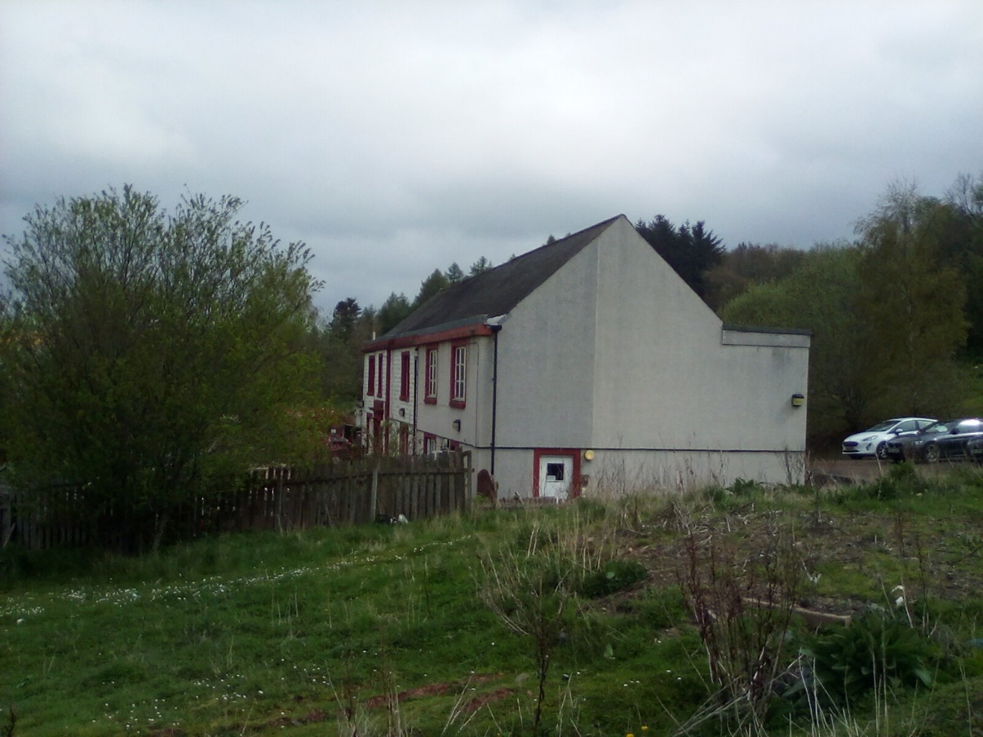
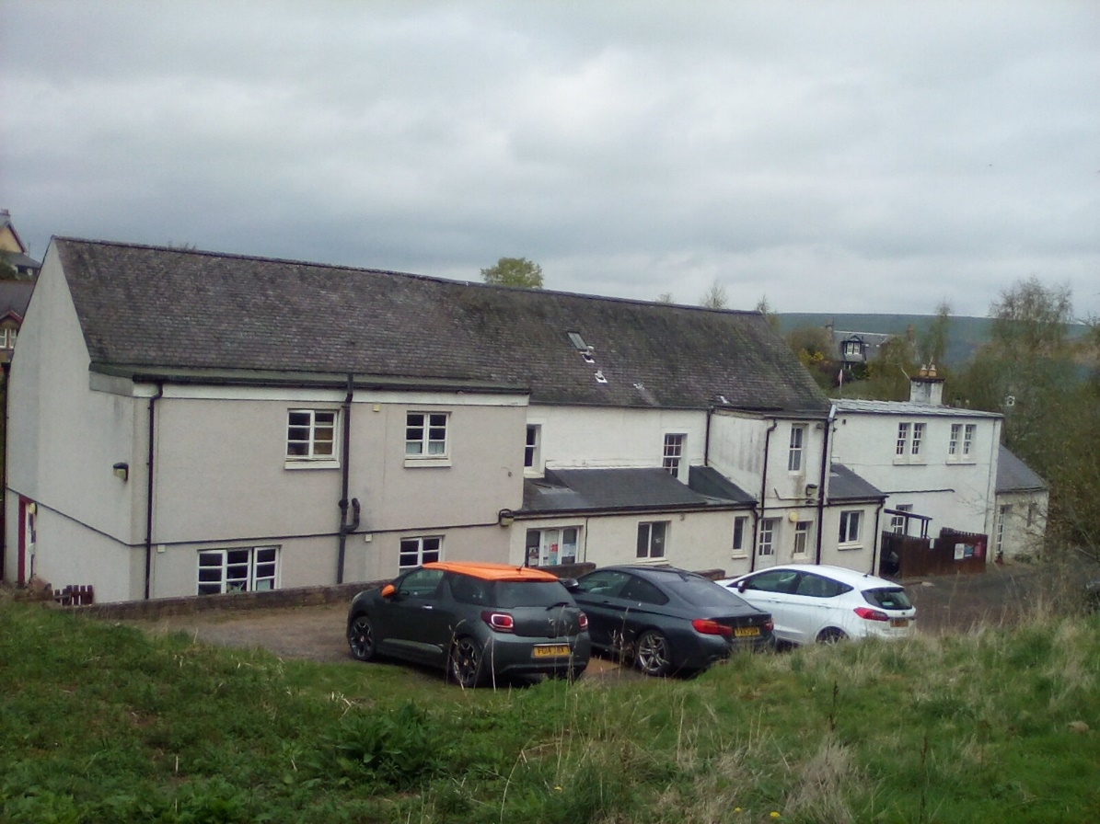

Our Nursery
Notes:
We are Emily and Tessa
We are a privately owned setting in Melrose, the Scottish Borders. We have a rural location, overlooked by the Eildon Hills and woodland. Our room caters for 3-5 year olds. Our open times are 7am-6pm with children in the building at all times throughout the day, we must use specific ‘paperwork time’ off the floor to complete tasks that contribute to developing our space. We have a staff team of 5, each taking on leadership roles and developing areas of our garden together. This presentation will cover our journey over the space of a year as we assess and adapt our space, setting up new and exciting experiences for our children.

Slide 2
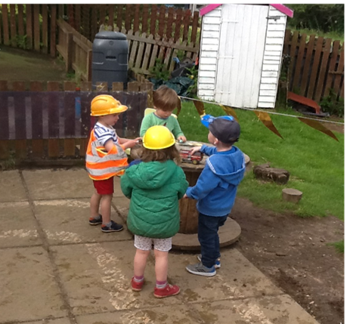

Benefits of Outdoor Play
“It is Undeniable that daily, high quality outdoor play experiences have a direct and positive impact on children’s physical, cognitive, social, mental health and emotional development.”
Realising the Ambition - Being Me pg 54
“Staff understand the positive impact rich, multi-sensory outdoor play and learning has on children’s resilience, health and wellbeing. Children have uninterrupted time to become absorbed in their play and
have fun.”
A Quality Framework for daycare of children, childminding and school-aged childcare’. Pg. 38
Notes:
We sent out a poster of information to parents about the benefits of outdoor play, keeping them informed of our progress.
We feel that these benefits are a great inspiration when thinking about how to design our outdoor spaces

Slide 3
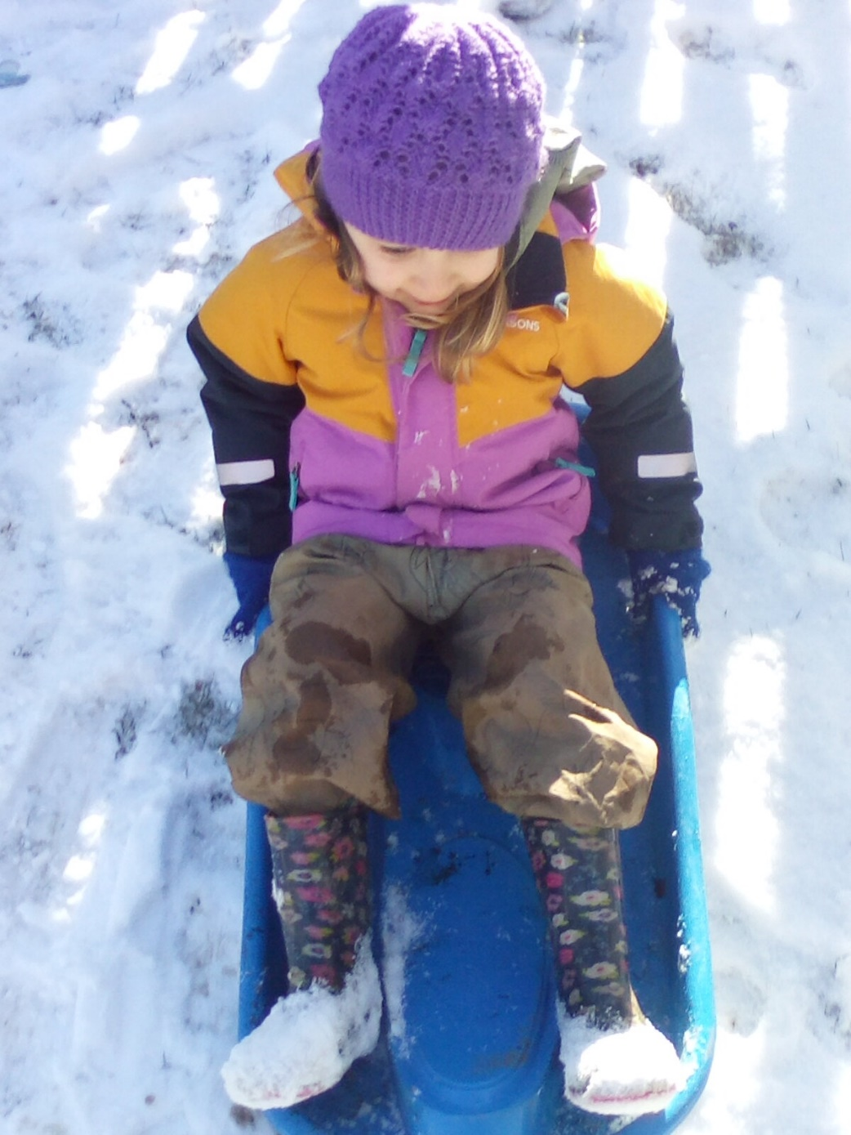
“…there is strong and compelling evidence that playing and learning outdoors has many benefits for children: Improves physical health, wellbeing, enhances child development, Improves learning for sustainability… And importantly, it is fun and should be an everyday part of children’s play- based learning!”
Building the Curriculum 2: Active Learning in the Early Years, Education Scotland 2007 (pg7)
“I need spaces that encourage a sense of safety and security, yet enabling appropriate risky play, which enables me to be playful in learning”
Education Scotland 2020 pg.29
“The goal is not to eliminate risk but to weigh up the risks and benefits. No child will learn about risk if they are wrapped in cotton wool”.
Health and Safety Executive 2012 pg.1
Notes:
Regular exercise and physical challenges develop gross motor skills and core strength
Messy play and large scale loose parts/construction and climbing can take place outdoors, this encourages learning in different ways.
Children need to push the boundaries of risky play to learn their capabilities and practice perseverance in challenging situations

Slide 4
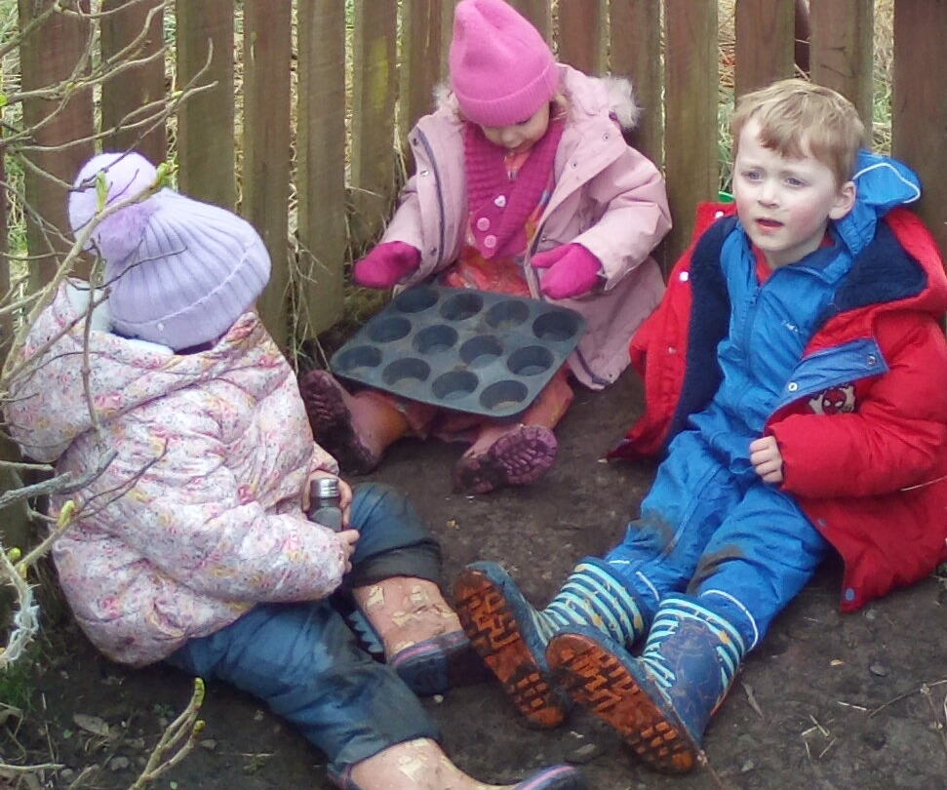
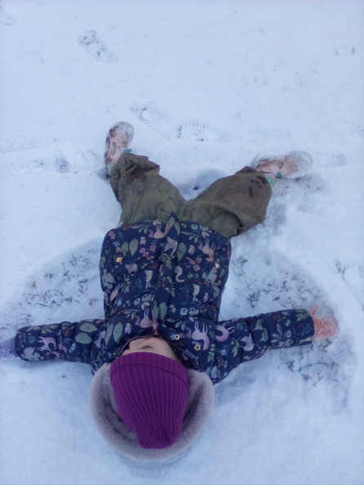
“Outdoor learning environments and engagement with the natural world offer regular high quality experiences that enable children to explore ideas and materials and to use their imagination freely”
“Children flourish when playing outdoors in all weathers. Being in nature stimulates the senses and nurtures a sense of wonder and awe at the process of life. Different natural spaces can simultaneously ignite creativity and imagination whilst fostering a sense of wellbeing and calm.”
Realising the Ambition, Being Me 2020 pg.56
Notes:
Outdoor play is an opportunity to promote social skills and interactions, building stronger bonds, relationships and empathy.
Connecting with nature and holistic play has a calming impact on senses
We still practice good hygiene, even outdoors! We set up our handwashing stations outdoors. Fresh air can prevent the circulation of germs in enclosed spaces. We learn about safety in different conditions such as suncream, warm outdoor clothing
It is proven that outdoor play improves Children’s Emotional Wellbeing, Increased Attention, Positive Thinking, Resilience, Mood Upliftment

Slide 5
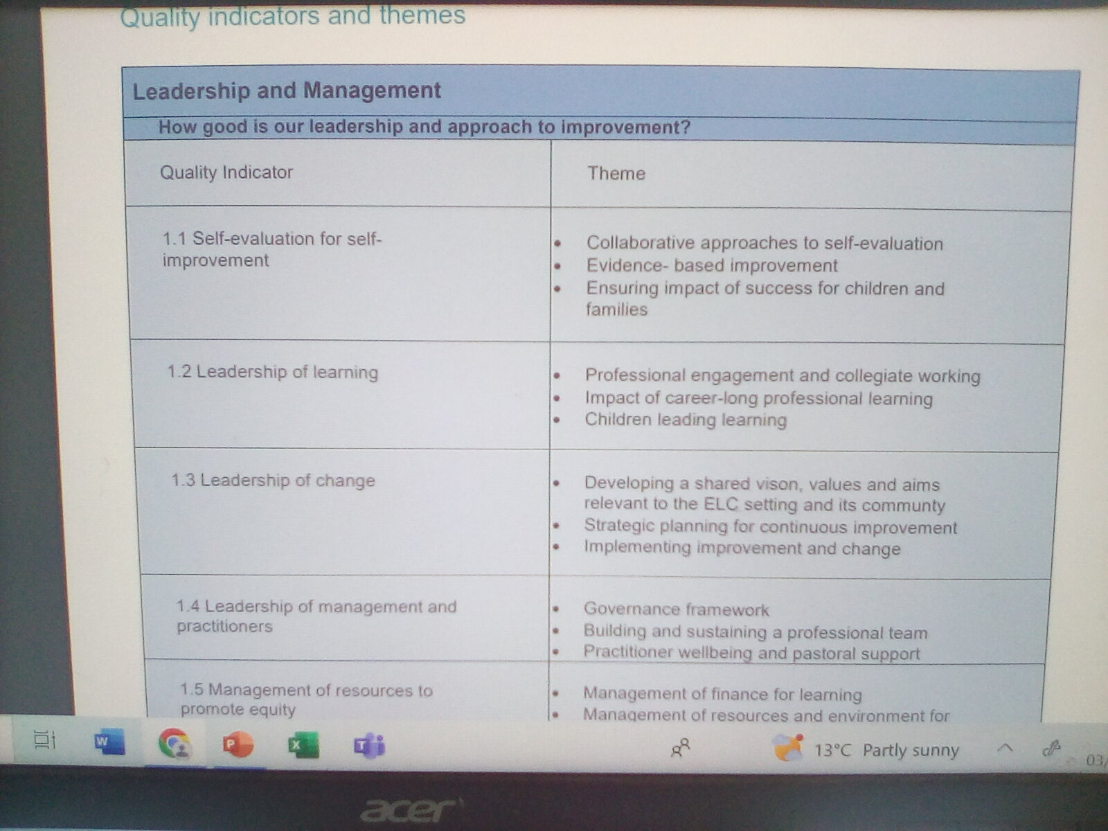
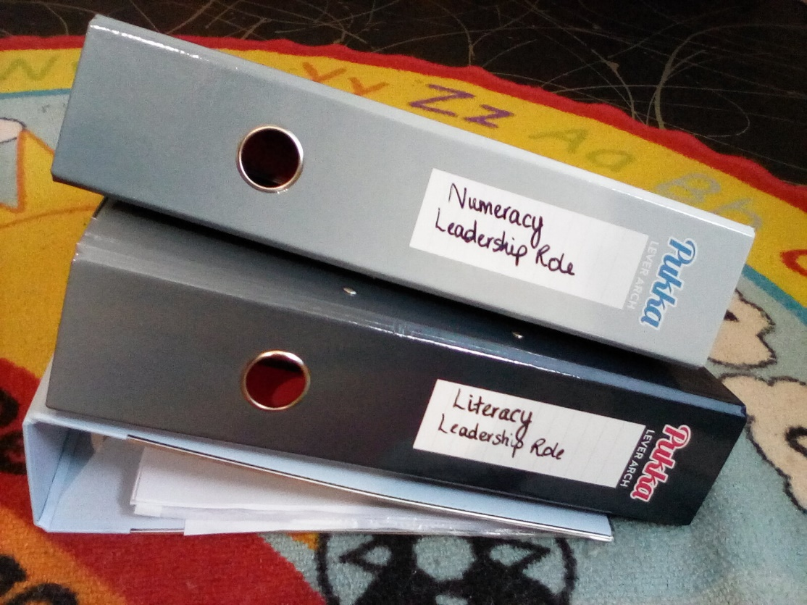
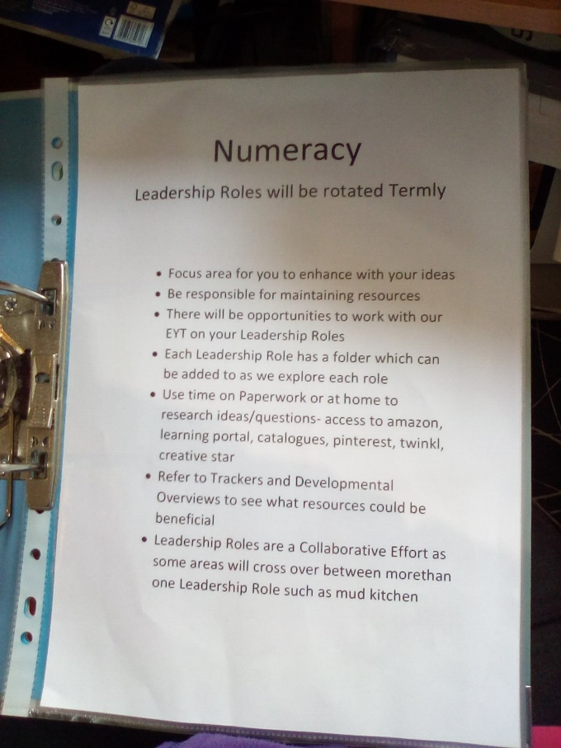
Our staff – Leadership roles
Leadership Roles
Next Steps
5 minute set up
Notes:
We have allocated new staff their leadership roles, creating folders with an explanation of each leadership role, the expectations, and providing structure with dividers to show who has completed which sections of work and so everyone can refer to each others research and relevant documents. We also discussed the leadership roles in a staff meeting and will give ongoing support.
Next step – we will be modelling to new staff and children the different areas in use – we will aim to have 2 ‘boxes’ or areas open at a time to ensure staff can model the use of resources and have quality interactions in these areas
5 minute set up – Anna Ephgrave suggests in her book that the garden ‘Planning in the Moment with Two and Three Year Olds’ that the garden will be used more productively and often if the garden is simple to set up with less large items to manoeuvre .
When considering development of our spaces we referred to the How Good Is Our Early Learning Centre theme 1.3.

Slide 6
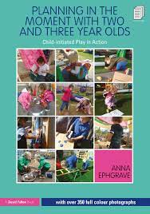
5 minute set up
Making the set up do-able
“If a workshop set up is developed, then indoors and outdoors should only take a few minutes to set up. Indoors, the water tray needs to be filled, the snack area prepared and the creative table restocked. The garden too should only take 5 minutes to set up and then it will be used every day. If it takes too long you might decide not to use that space on some days.” Planning in the moment with Two and Three Year Olds – Child Initiated Play in Action 2020
Notes:
Anna Ephgrave suggests in her book that the garden ‘Planning in the Moment with Two and Three Year Olds’ that the garden will be used more productively and often if the garden is simple to set up with less large items to manoeuvre .
To Keep the garden safe we also complete risk assessments before heading outdoors, staff have a checklist to work through. Our future plan is to develop a children’s checklist for a child or small group to develop an understanding of risk assessment and responsibility – this tie’s in with our ‘Responsible Robbie’ and ‘Safe Stella’ Health and Wellbeing Indicators.

Slide 7
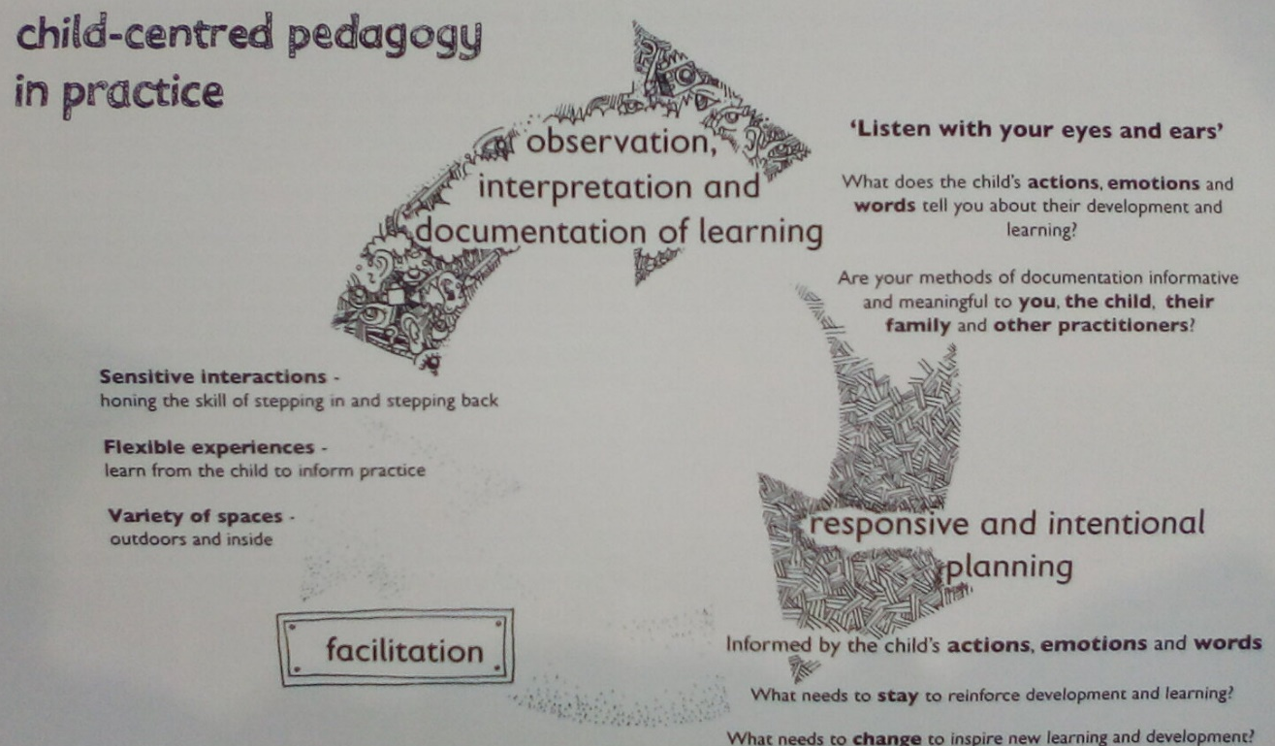
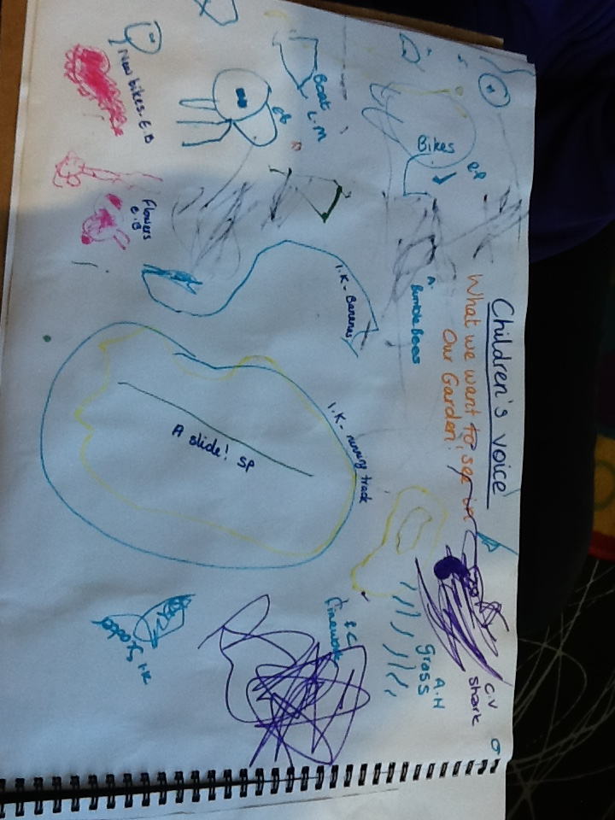
Childrens voice
Realising the ambition – Being Me pg.48 (diagram on right)
‘4.4 The role of the adult in supporting learning
We need to value play and take time to observe the child’s learning through play in order to deepen or extend their learning. Stepping back and noticing what the children are involved in is a skill that must be embedded into practice both in ELC and school settings. After reflecting on the key learning for the child we can facilitate a provocation or response to allow the child to further pursue their own thinking. The provocation/response allows further time for us to capture what the child’s thinking is prior to interacting with them and then developing a plan for building or extending the child’s thinking.’
Realising the ambition – Being Me pg.49
‘Children can influence when they play outdoors every
day and regularly explore a natural play and learning environment. Children are confident in exploring and developing their outdoor environment, supported by staff who actively support and encourage children in their endeavours.’
A Quality Framework for daycare of children, childminding and school-aged childcare’. Pg. 37
Notes:
We also use our floorbook to record children’s voice with regard to our outdoor areas and what they would like to see on offer/what they like and dislike.

Slide 8
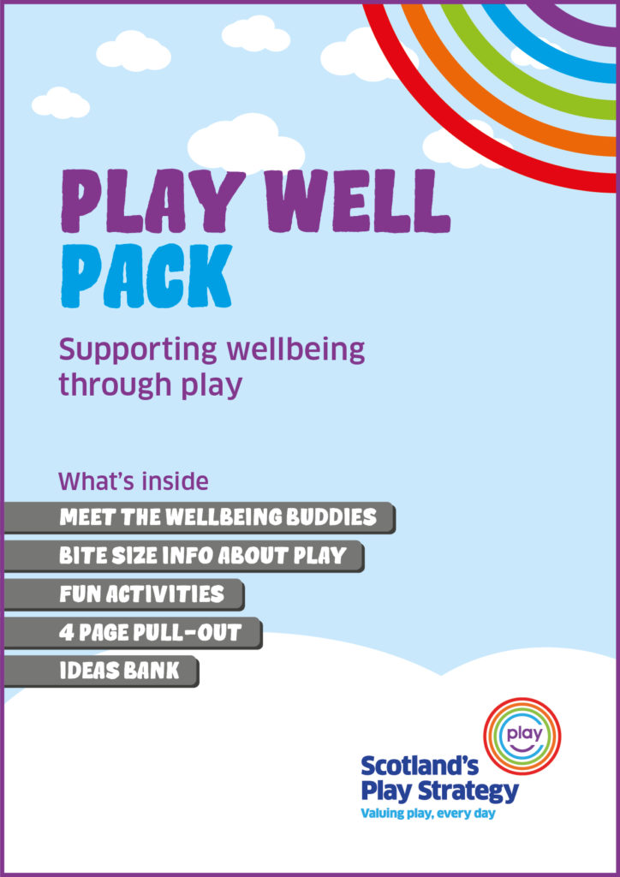
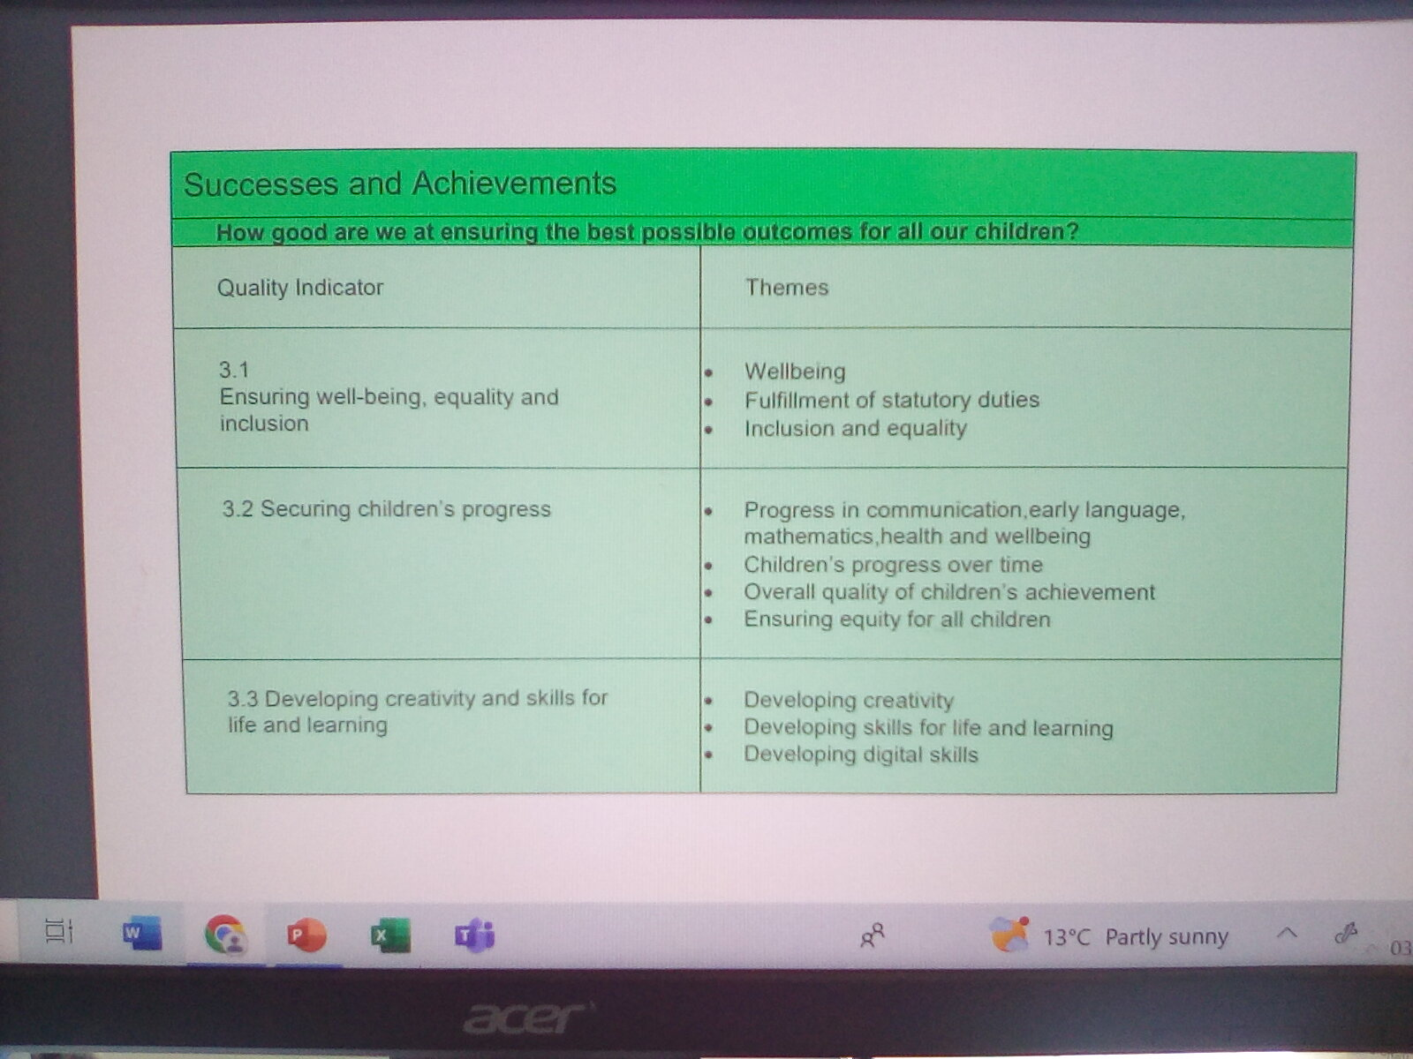





Staff Training
Early Years Team Training and Portal
Play on Pedals
Moderation training In-Service
Home reading/Relevant documents
Health and Wellbeing Buddies
A Quality Framework for daycare of children, childminding and school-aged childcare’.
Notes:
As a staff team we try to keep on top of any available training to inform our practice. We benefitted hugely from the training courses supplied by the early years team such as Emerging Literacy and Quality Interactions over the COVID lockdown.
A member of our staff attended this training on 8th March. This training helps us identify safe cycling areas, identifying key moments in riding a bike, fun cycling activities that can be done, appropriately risk assessments and correct cycling equipment
Tessa and Emily were able to attend the in-service day training with the local authority settings staff in Earlston, which helped us understand the use of the developmental overviews and tracking sheets that we use and how our use compares to other settings. These documents are important in how we plan experiences and resources.
In our practice we constantly refer to and use documents such as Realising the Ambition and HGIOELCC to influence our everyday experiences, how we plan, evaluate and connect our next steps.
Our Wellbeing Indicators are tied in with experiences and our routines throughout the day, We use these through stickers for recognising achievements, and parental contributions also familiar the children with this terminology at home.
We have also observed the document ‘A Quality Framework for daycare of children, childminding and school-aged childcare’, considering the quality indicators in our development of the outdoor area.

Slide 9
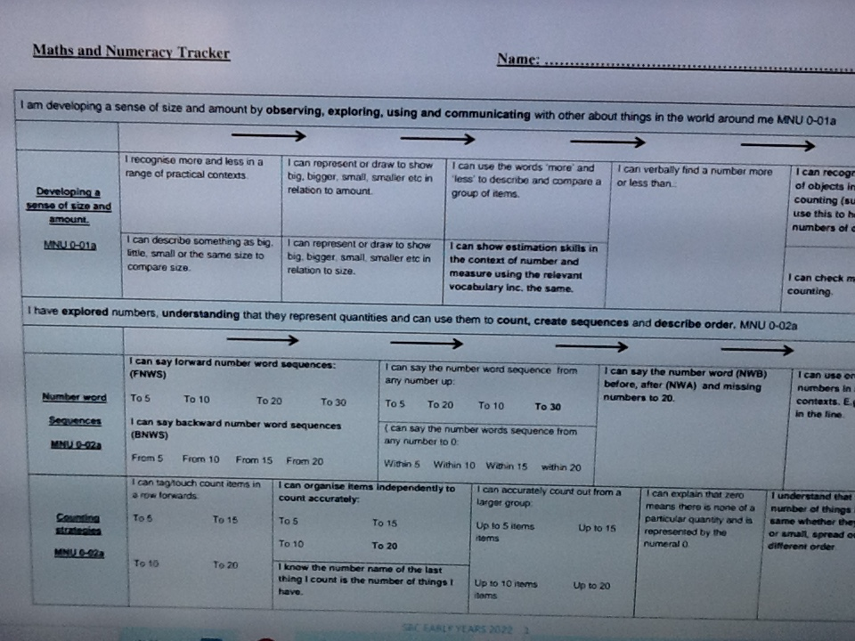
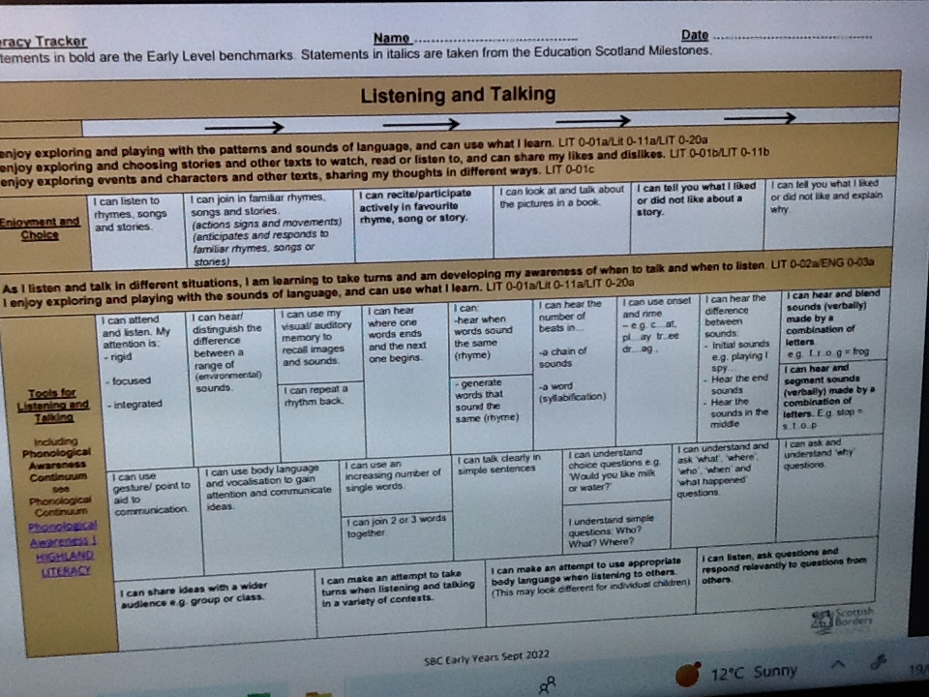
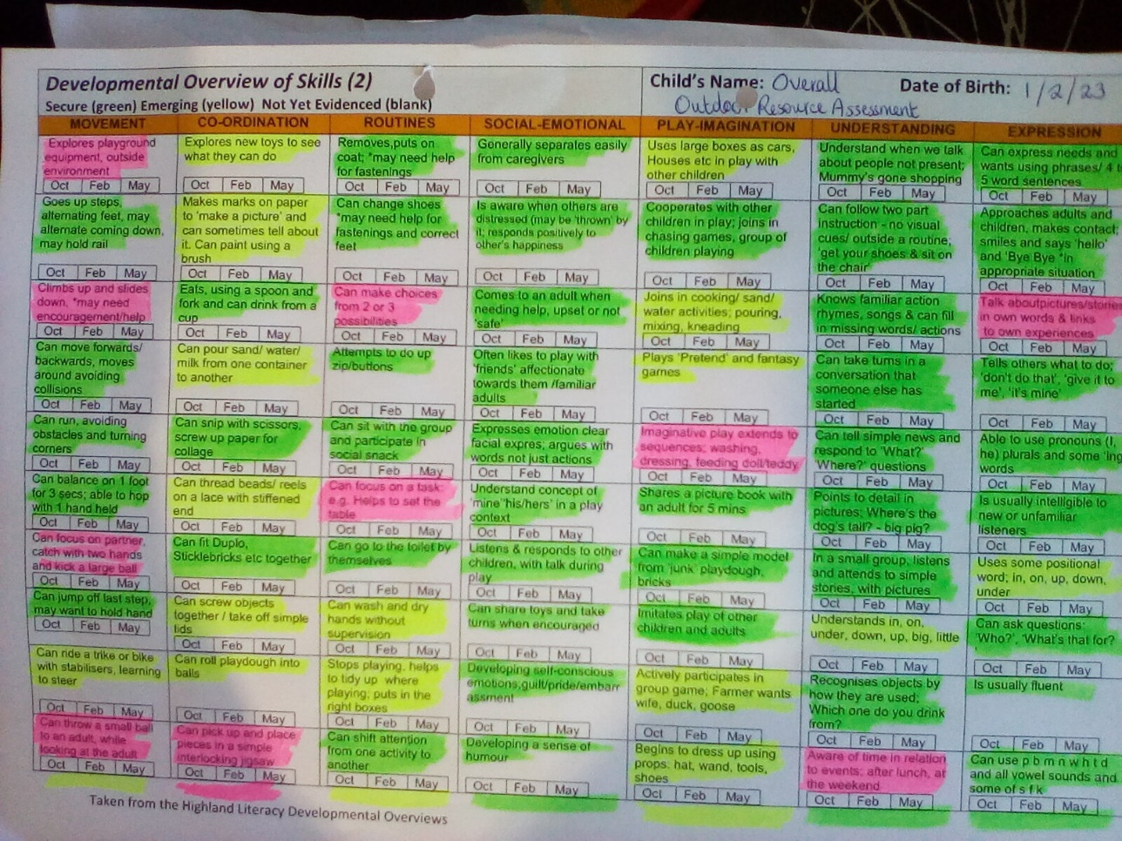
New D.Os/Trackers
How we are incorporating these in to our garden plans?
Developmental overviews
Trackers
Notes:
We have assessed our garden in line with the developmental overviews and filled in with colours according to our resources to support the learning strands, this shows what resources we have, need to enhance or add. We used a colour coded system – green for resources already in place, yellow for resources that need enhanced and red for resources that need to be sourced.
We are using Leadership roles and children’s next steps to ensure children have a full breadth of experiences, promoting key areas such as Numeracy , Literacy and Health and Wellbeing
We can link tracking children’s progress and knowing our children as learners through HGIOELCC theme 3.2

Slide 10
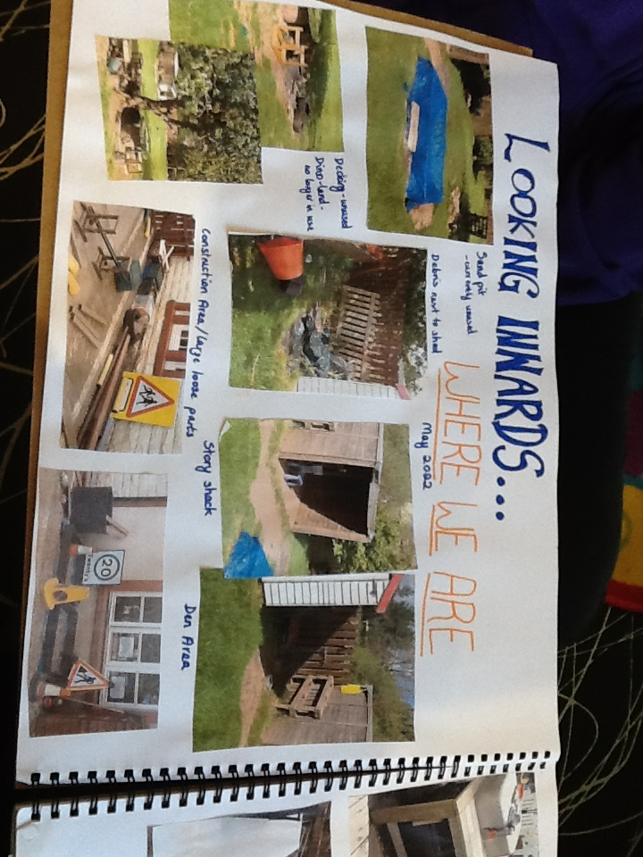
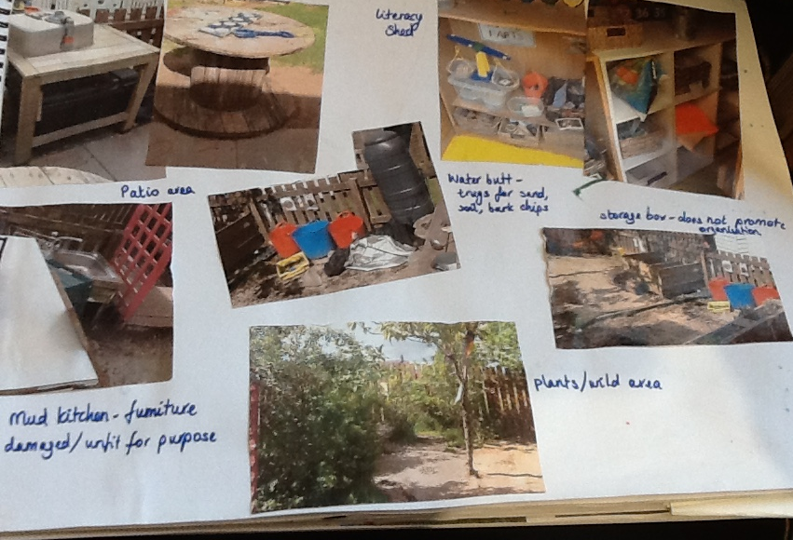
Sections of the garden/layout
Notes:
We looked inwards - Each area was assessed as to what resources were in place, what we needed, we also sought advice from our EYT for some ideas as well.
Staff voice – working as a team and sharing ideas about each experience
Children’s voice – floorbook pages (shown in later slide) group discussions, observations of areas in use
On evaluation we decided to split the garden in to leadership role areas to evenly distribute responsibilities to each staff member to research and contribute their own ideas alongside the children’s voice. Next we will outline each leadership role, which experiences are included in each role and examples of these areas in use.

Slide 11

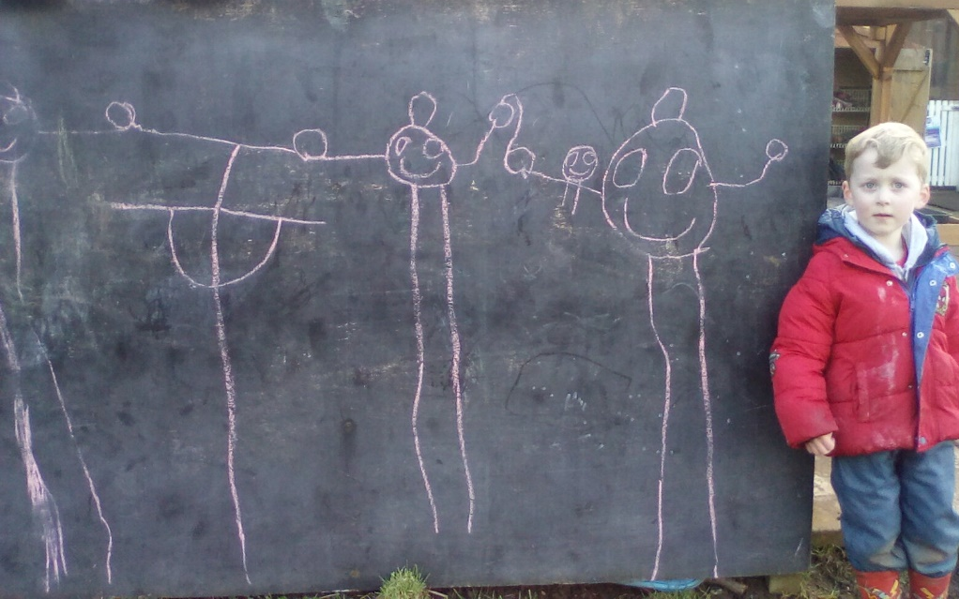
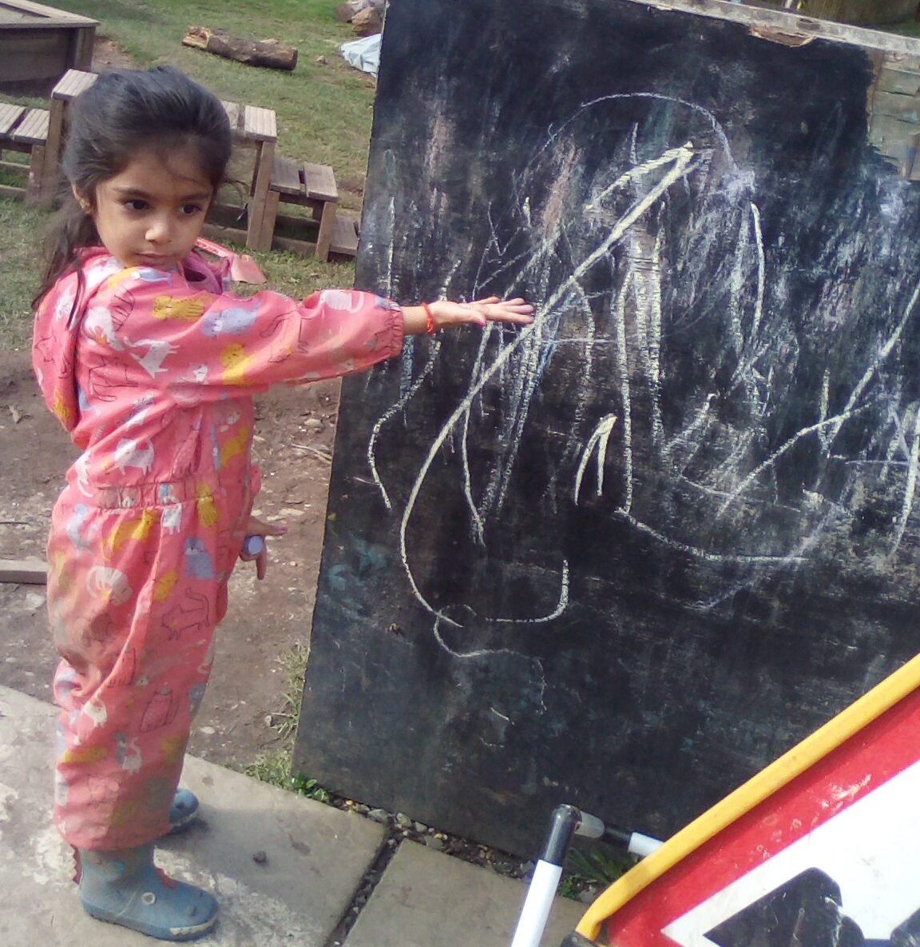
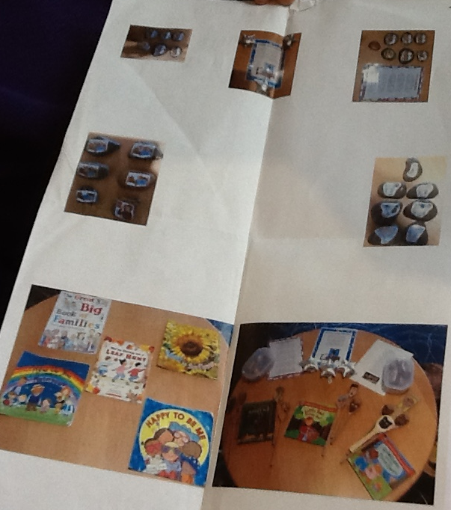
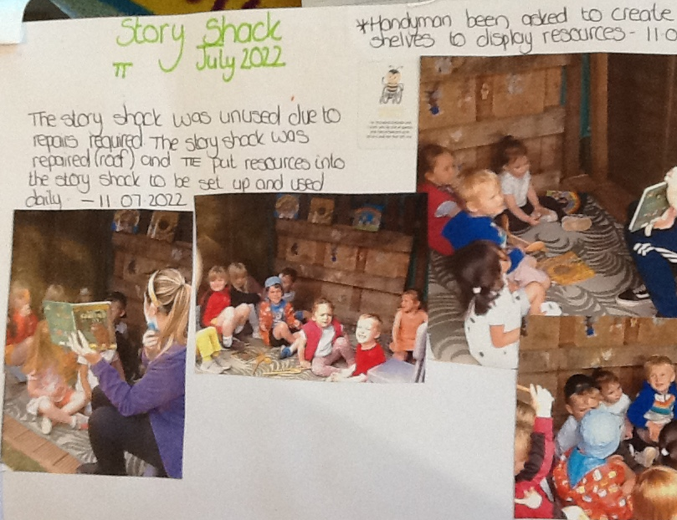
Literacy
Literacy Shed (Mark Making Opportunities)
Story Shack
Environmental Print
Chalk Board
Notes:
We provide waterproof suits for all children to promote being outdoors in all weathers. In warmer weathers we provide suncream and sun hats where needed.
We have the core provisions accessible for all children everyday so they all have the opportunity to have these experiences
The children are involved in choosing which wellbeing indicators are most relevant to celebrate their achievements, particularly during group discussions or while completing the floorbook together.

Slide 12
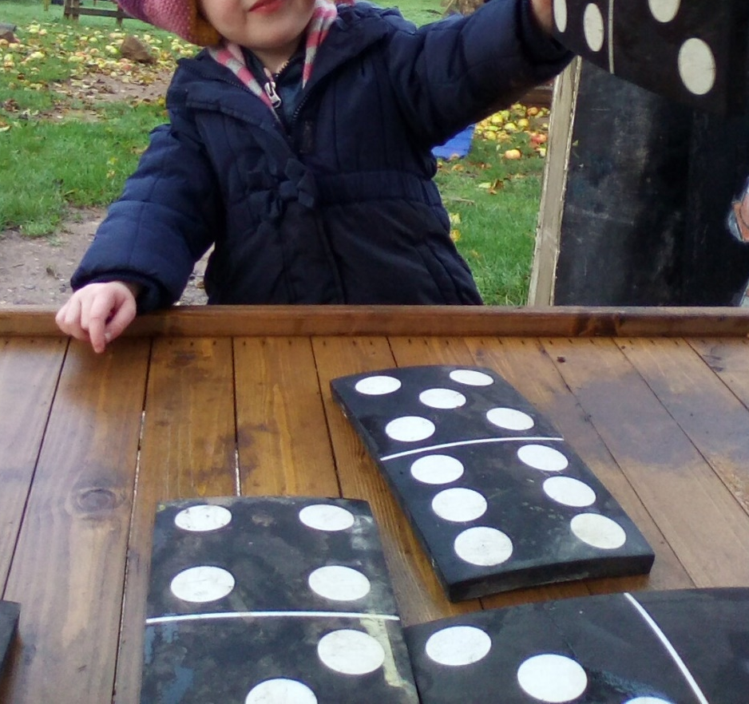
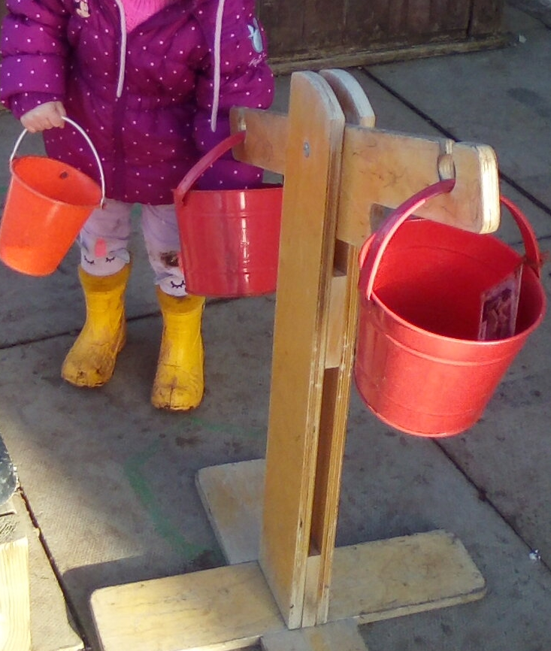
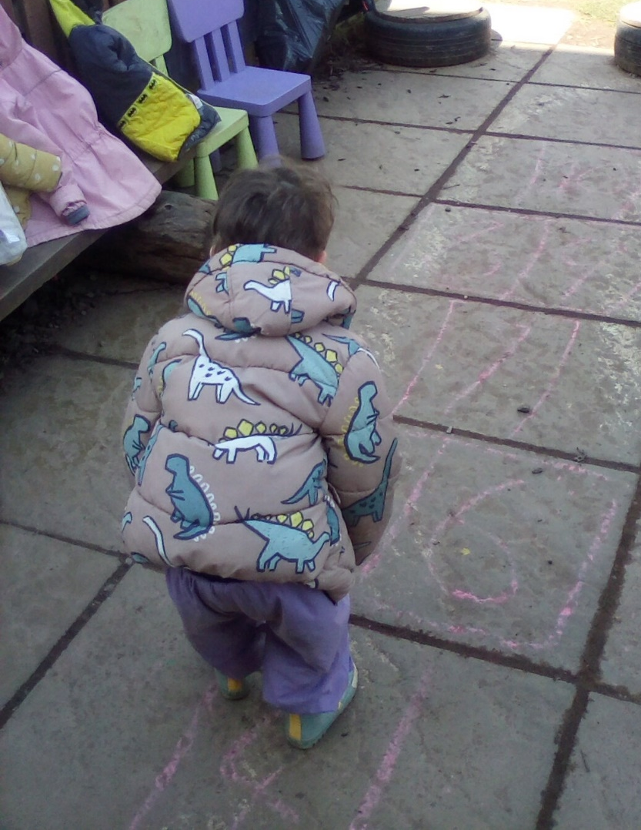
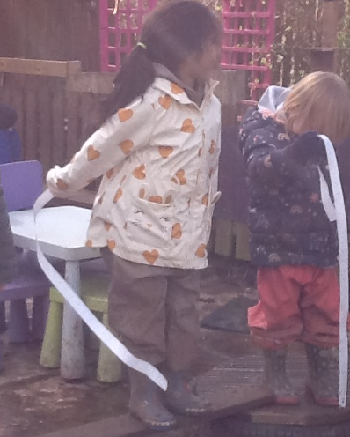
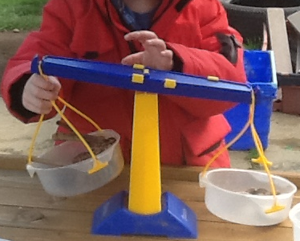

Numeracy
Signage
Planned Experiences
Mud Kitchen measurements
Calendar/Seasons/Time as part of daily routine
Technologies
Measuring
Loose parts

Slide 13
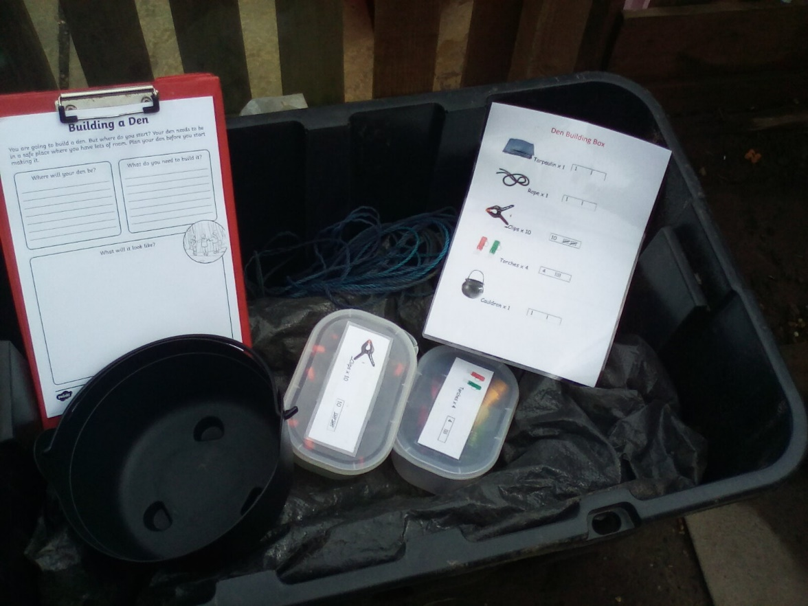
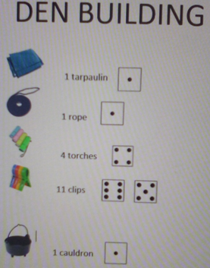
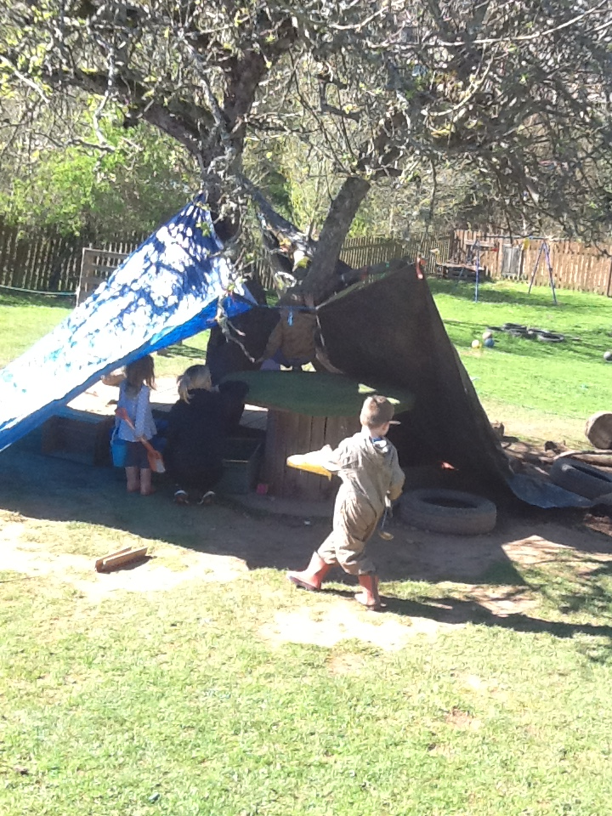
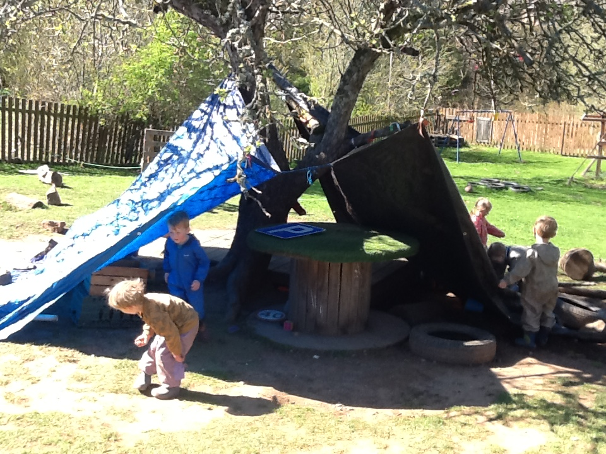
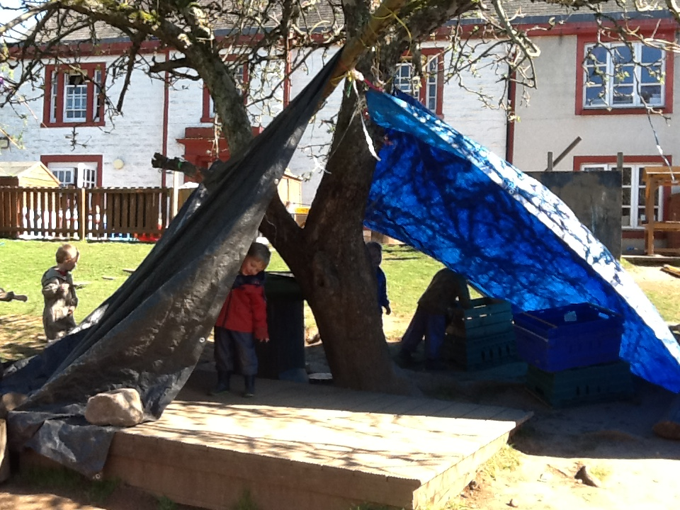
Den building
Den building Box
Enhanced resources
Notes:
We created a den box with contents list, boxes for smaller items such as torches and clips
We enhanced the area by adding torches and a cauldron for more potential creative play. Further additions could be added depending on current planning etc

Slide 14
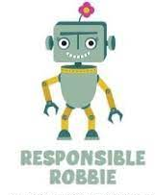
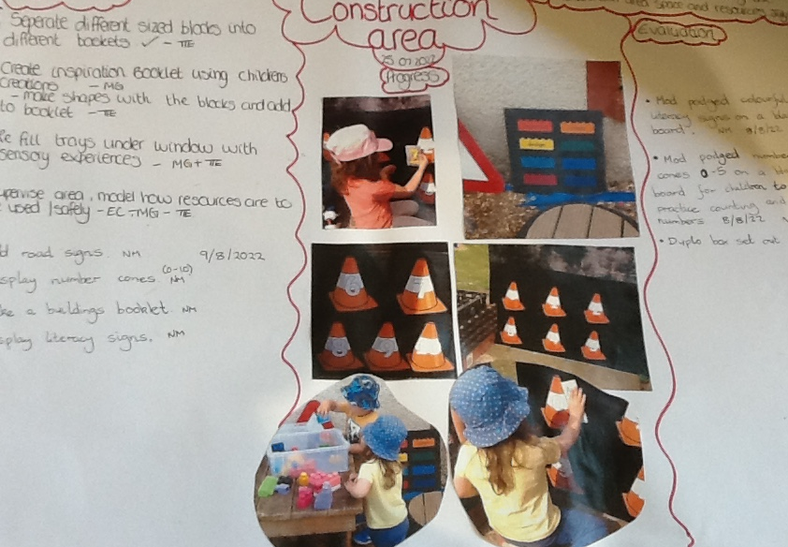
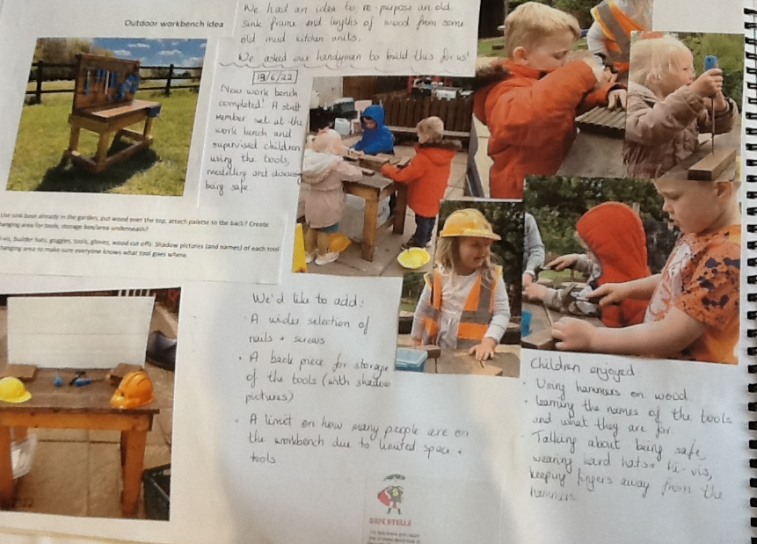
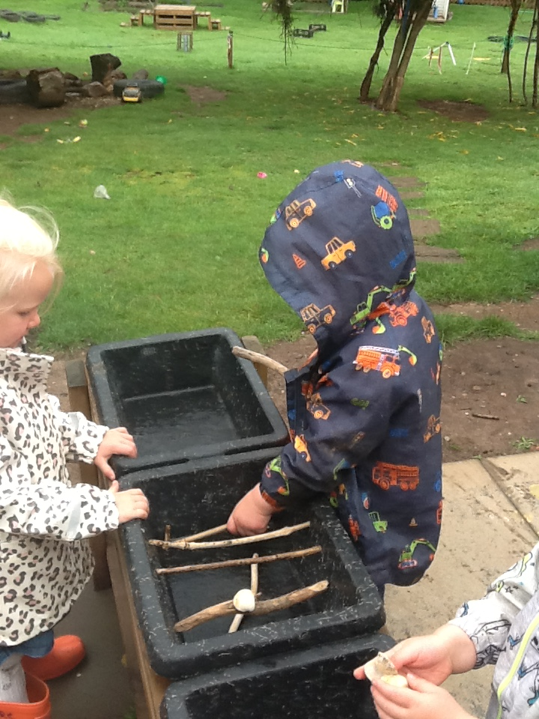
Construction
“Staff embrace a risk benefit approach and
support children to safely engage in play to
push their own boundaries and build self confidence.”
A Quality Framework for daycare of children, childminding and school-aged childcare. Pg. 39
Outdoor Construction
Choosing Units
Loose parts
Notes:
When handling dangerous tools we are cautious about always having a staff member based at the workbench to supervise and model use of the tools

Slide 15

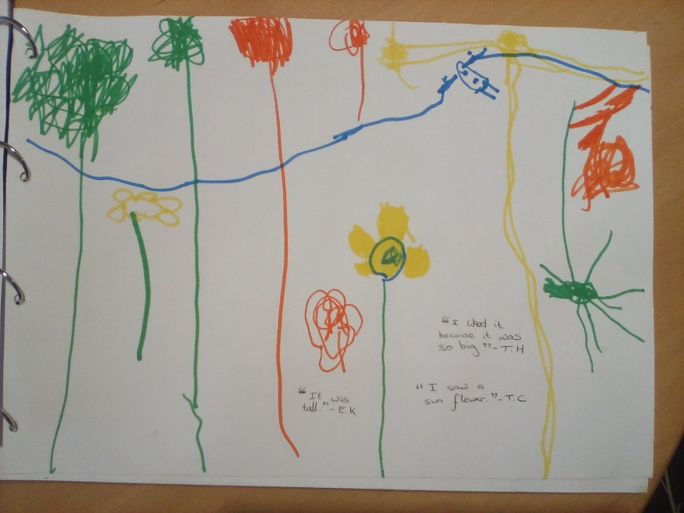
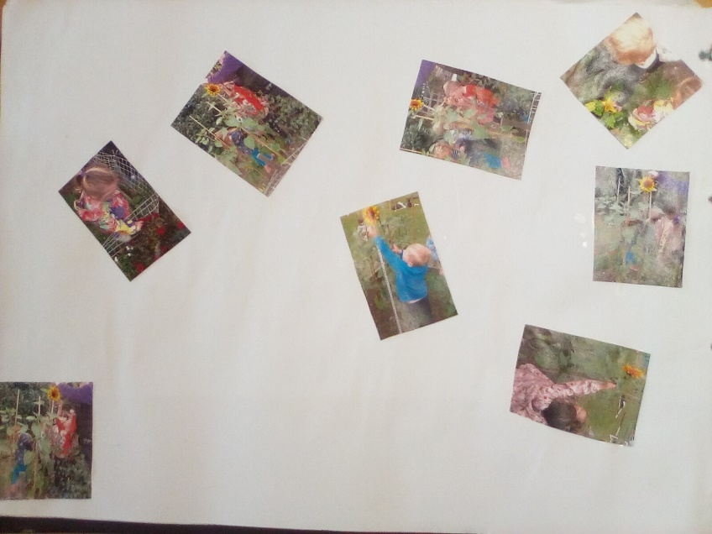
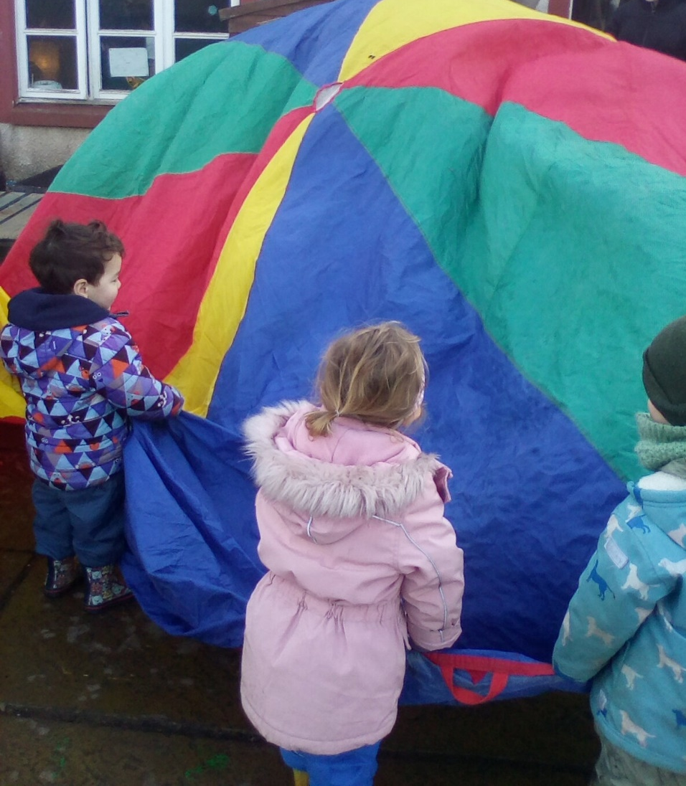
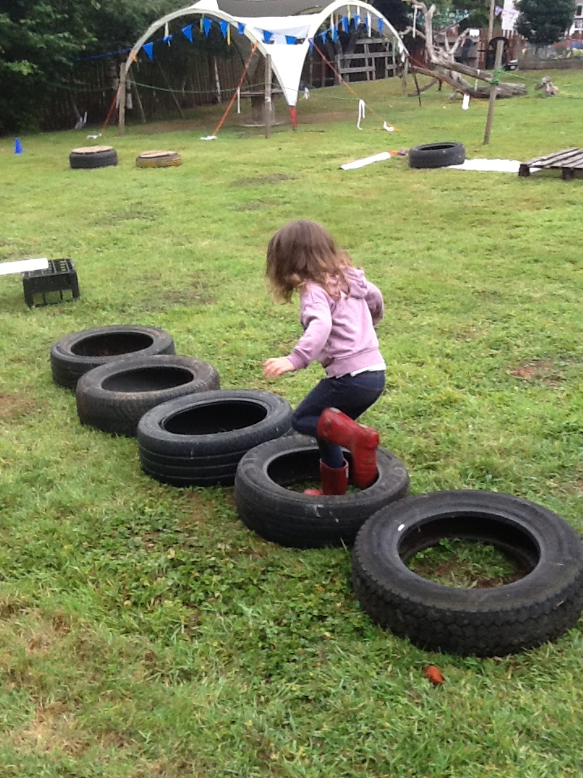
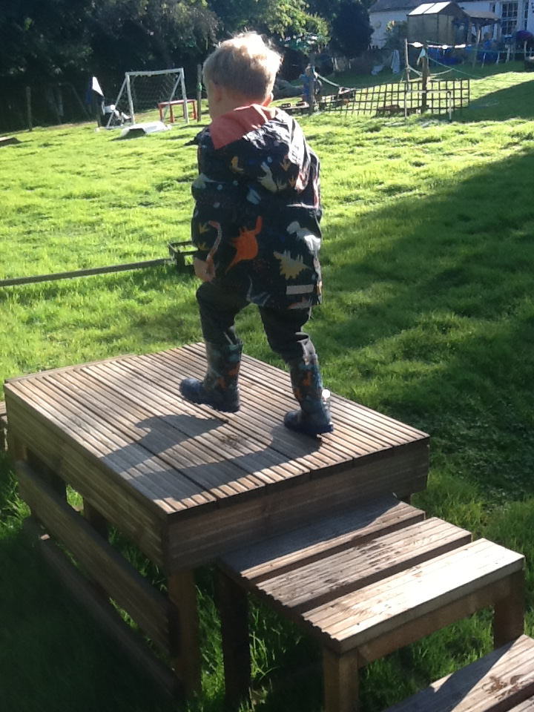
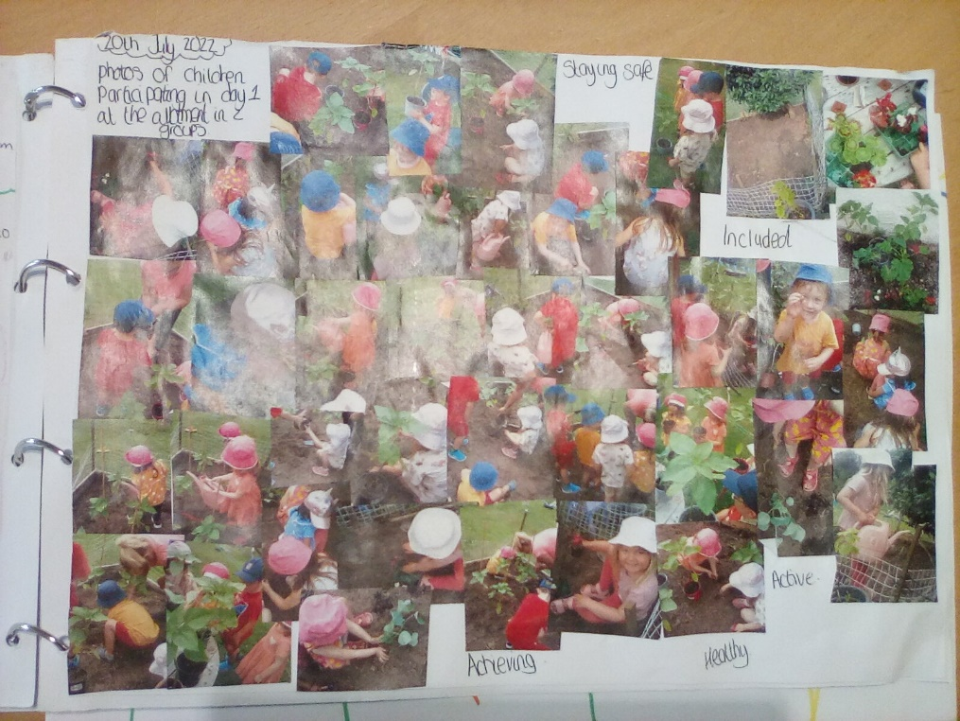
Physical Challenges
Explorative Play
Music Wall
Health and Wellbeing
Notes:
We have used large loose parts and climbing apparatus as part of obstacle courses, or sports day events to promote physical challenges, as well as our core provisions.
We cover the health and wellbeing trackers growing seedlings and discussing parts of the plants, we have even sent sunflower plants home to continue their growth!

Slide 16
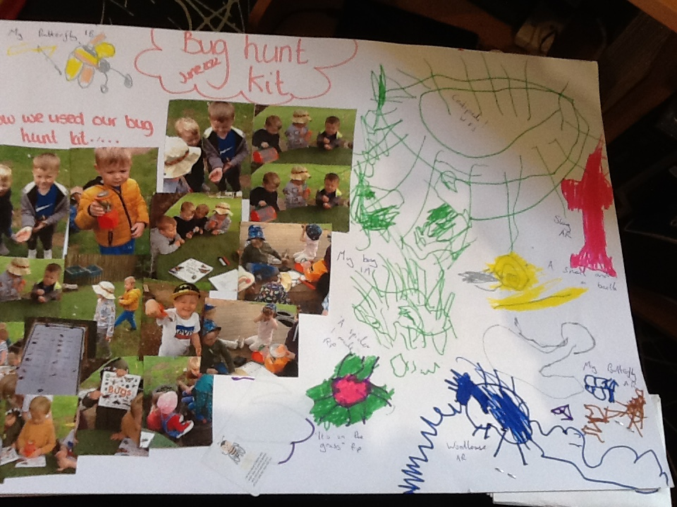
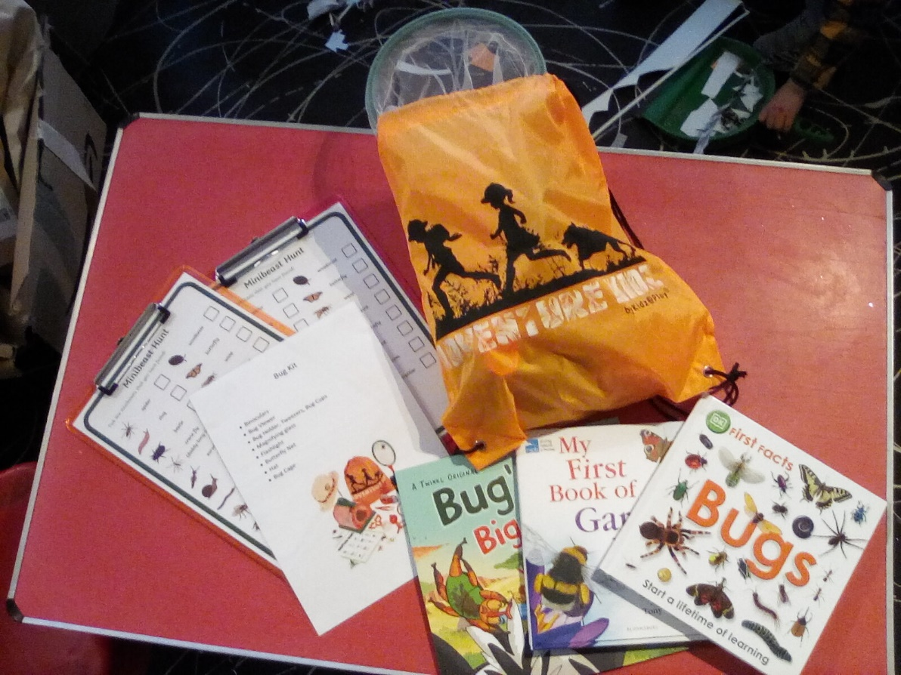
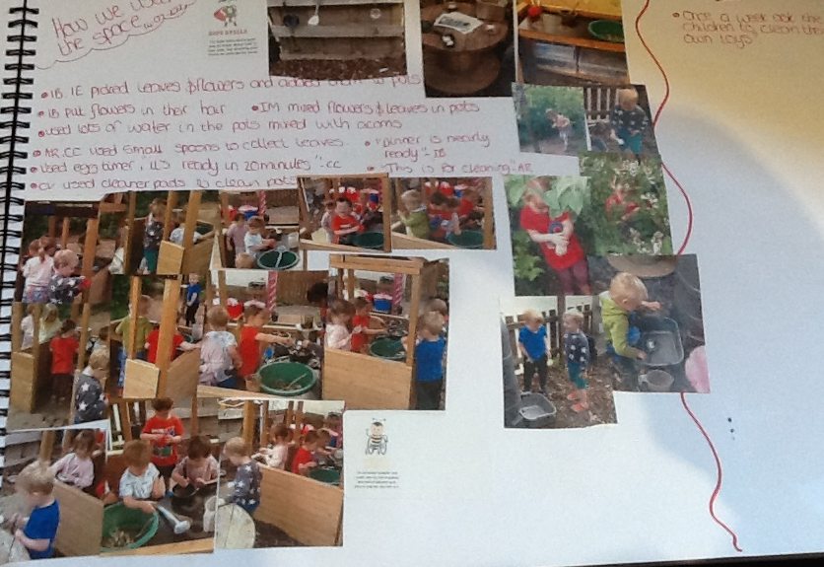
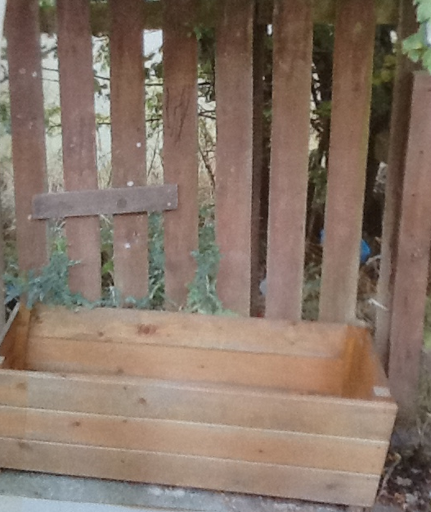
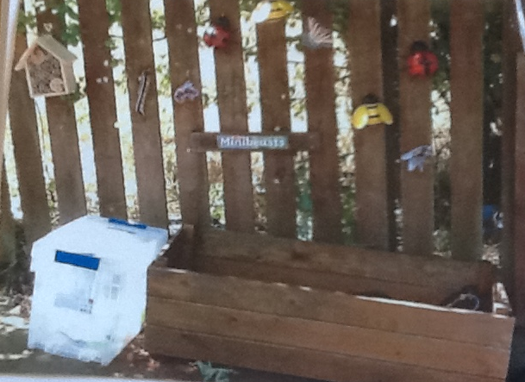
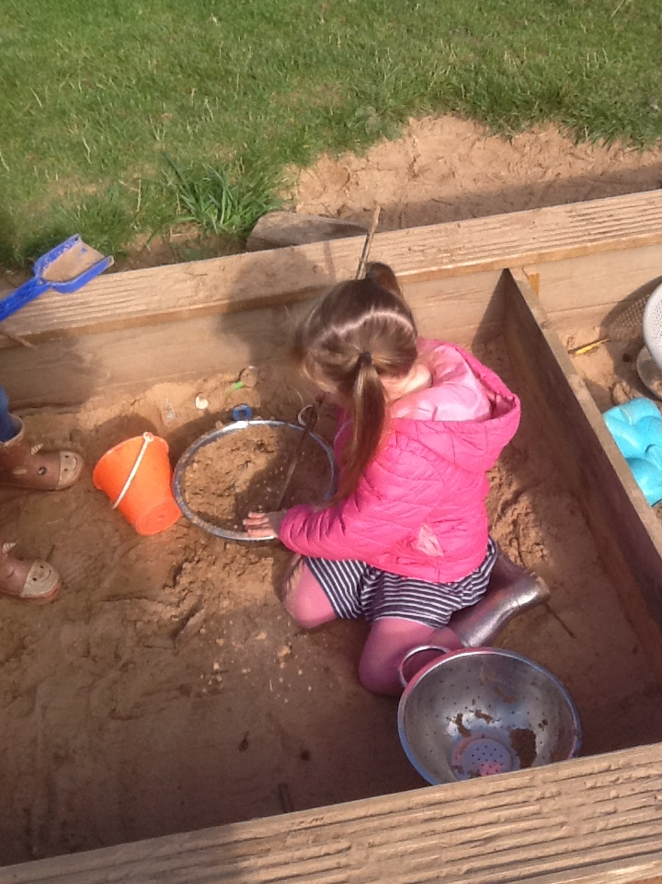
Messy Play
Bug Zone/Bug Hunt Bag
Sand Pit
Water Tray
Notes:
The children showed a growing interest in finding bugs in the garden, so we responsively set up a ‘bug zone’ with supporting books to help with identification and some bug hunting kit!
The sand pit and water tray make up part of our core outdoor provisions.

Slide 17
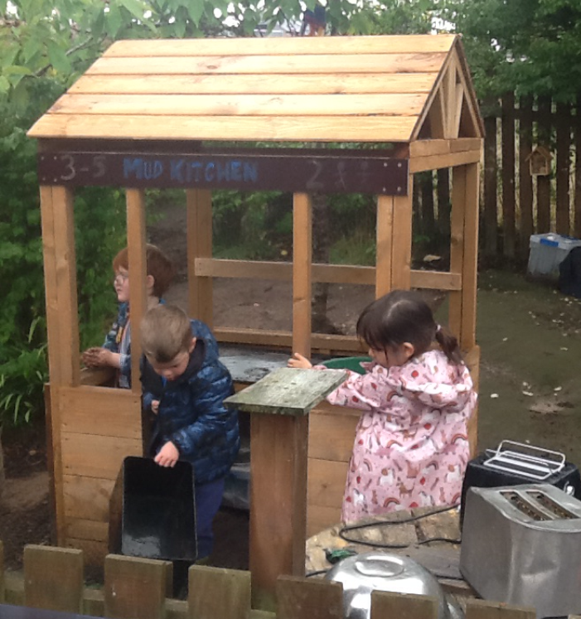






The mud kitchen journey
Well-functioning arrangements for monitoring, maintenance and repair of the setting, equipment and vehicles are consistently implemented. Damaged items are promptly replaced.
A Quality Framework for daycare of children, childminding and school-aged childcare’. Pg. 37
Notes:
The mud kitchen has had a big transformation, was the first area to be developed and is our most popular area for play in the garden
Poor quality furnishings, lack of structure in resource storage, the need for ‘food’ to use in the mud kitchen
Real food – led to rat problem, substituted with bark chips, sand, water and soil
New quality furnishings sourced, set up to make area feel useable and spacious enough
Organisation of pans, utensils etc in to storage boxes to allow for rotation of resources
Cleaning system for mud kitchen toys to be added, for children to take responsibility

Slide 18




Parent communication
Weekly door sheets
Regular facebook posts
Observation sheets photocopied and sent home
Termly newsletter
Regular updates about our progress on pedagogy pioneers e.g newsletter
We also created a pre-writing skills poster for parents and fellow practitioners
Notes:
Our parents are made up of mainly keyworkers from the hospital etc and have struggled in the past to run stay and plays due to poor turn out. This is something that we may try to re-introduce in time. We make up for this by being as vocal as we can through social media and news that parents can read in their own time.

Slide 19




How we manage and supervise successfully
Rotating Resources
Future plan – Children’s Responsibilities
Notes:
We use a chart to indicate which experiences are open each day, alongside our ‘core provisions’ such as mud kitchen, sand pit, mark making. These ‘core provisions’ can be enhanced to compliment the intentional promotions, next steps etc.
Our next steps in terms of children’s responsibilities in the garden is to allocate our ELC 4s areas in the garden to be responsible for. This would include helping to set up areas during risk assessment, using printed inventories with symbols or numbers to check everything is put away correctly, and showing younger children how we use the resources.
We have studied the safeguarding theme from HGIOELCC through training exercises to understand more about garden safety, keeping our areas safe and secure with robust fences and gates

Slide 20

Next Expectations/Analysis
What have we learned – overwinter damage/refresh
Storage
Quality furniture
Child/Cohort study
Notes:
Appropriate storage during winter months that is robust so that resources will last over winter
High quality fully treated outdoor furniture that will withstand the weather to avoid having to keep replacing items/overall spend more by constantly replacing furnishings
Using the new developmental overview and trackers it would be interesting to see over the space of a year how the outdoor play area and resources can broaden children’s learning. This could be done through individual child studies or through a full cohort study.

Slide 21

Questions
We are happy to answer any queries you may have!

Slide 22

Thankyou for listening to our presentation

